Slide 1
National Summit on e-Forms
XForms as an integral part of SOA strategy
Gopi Srinivasan
India Technical Head - WPLC Business

Slide 2
Agenda
  Introduction to xForms
  Overview of Service-Oriented Architectures (SOA)
  xForms and Service-Oriented Architectures
  Q & A

Slide 3
Definitions and Terminologies
e-Forms:
An e-form is an electronic document that presents information and gathers responses to that information.
XForms:
XForms 1.0 is the W3C recommendation for the next generation of Web-based forms. The recommendation provides an XML vocabulary for describing a business processing model.
XForms is not a free-standing document type but is intended to be integrated into other markup languages such as XHTML, OASIS OpenDocument, SVG, or XFDL.
Service-Oriented Architecture
SOA is being accepted as the next evolutionary step in solution architecture. The benefits are broad, ranging from reduced integration costs, improved reusability, and the ability to leverage existing infrastructure investments.

Slide 4
XFDL
An XFDL processor is a software program that reads, processes, and writes XFDL forms. Processing may include such tasks as GUI rendering, data extraction, or modification.
Is a publicly accessible open standard
Represents forms as single objects without dependencies on externally defined entities, thus allowing them to act as contractual documents.
Is represented by human-readable plain text.
Provides a syntax for inline mathematical and conditional expressions.
Permits the enclosure of an arbitrary size and number of base-64 encoded binary files.
Offers precision layout needed to represent and print dense business/government forms.
Facilitates server-side processing via client-side input validation and formatting.
Permits extensibility including custom items, options, and external code functions.
Offers comprehensive signature support, including:
  􀂄 Capture of the whole context of a business transaction
  􀂄 Multiple signers
  􀂄 Different signers of (possibly overlapping) portions of a form
  􀂄 Freezing computations on signed portions of a form
Maintaining the data, logic, and presentation layers in a single, legally binding document is a paradigm shift in electronic commerce, which traditionally separates each layer.
The decision to use a more “document-centric” model was not made lightly — it was found to be necessary in order to provide legal non-repudiation.

Slide 5
e-Forms

Slide 6
E-Forms Spectrum
Process-Centric
5
Enterprise Content (Case) Management
4
. . . Store, Process and Preserve
($154.00 Savings per Form**)
Value and ROI
Content-Centric
3
Fill, (Sign) & Submit
($97.00 Savings per Form**)
2
1
Fill & Print
($16.25 Savings per Form*)
Print & Fill
($14.00 Savings per Form*)
Print & Read
Business / Process Enablement
Notes:
As this chart shows you can look at eForms from a Content-centric view or a Process-centric view. The entry point or the 1st Level being something we are all very familiar with I’m sure, which is a Print and Fill form. Take it from the web, print it, fill it out and then most likely mail it in for processing. There is SOME value with this (we provided the user or customer with the form from a web site versus having to mail them a copy) . . . , like I said, some business value. . .
But as you go up the value curve, you will start to realize a larger Return on your Investment and it can exponentially grow when you start to cross into the process spectrum. For example, Level 3, an environment to where you allow the user or customer to electronically fill a form out on the web, optionally sign it and submit it for backend processing. We have seen a tremendous increase in investments being made putting paper processing online, and using automation to do more of the work, a Fill and Submit type of an eForm is an excellent example of this.
The other levels of eForms processing, (4 and 5) are an extensions to the Fill and Submit example, to where you are truly adding an electronic workflow to the form once it has been submitted. Level 5 is when you make the Content (the form) part of an ECM or Enterprise Content Management environment. Meaning you allow for resuse of the form or Content in other applications or part of larger overall storage strategy, an example might be a Customer Folder concept – to where the eForm is one piece of content in the overall electronic customer folder. <NEXT CHART>

Slide 7
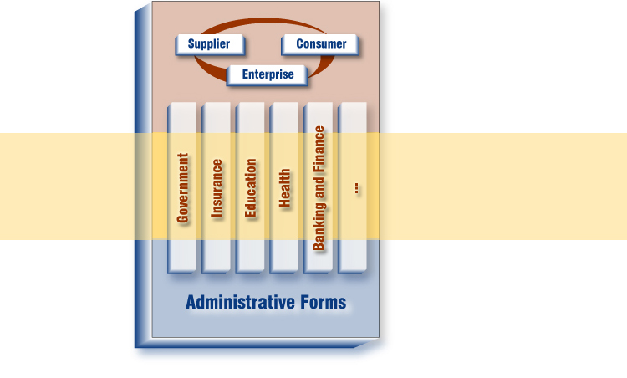
e-Forms are Everywhere
Key Components
Security and Scalability
Platform Impendence
Standards & Ease of Use
External
(Enterprise)
Key Components
Scalability and robustness
Document Management
Forms Management
Vertical
(Enterprise)
Key Components
Cross-Platform
Use of existing environment
Rapid Application Development
Horizontal
(Workgroup)
Notes:
There are drivers within the verticals – HIPAA in Healthcare, or Paperwork elimination act within Government

Slide 8
Non-standard based Web e-forms
When developing e-form applications, you are faced with
a range of challenges and design-decision trade-offs.
Historically there have been two main options for delivering e-forms on the Web:
  HTML e-forms
  Proprietary technology

Slide 9
HTML e-forms
HTML forms have been used for some time and are well suited to simple data capture via Web-based solutions in which little-to-no integration is required with back-end systems.
The pains associated with implementing enterprise HTML e-form applications include:
  Poor separation of data and presentation
  Data-centricity (versus document-centricity)
  Difficulty of componentization and reuse
  No offline usability
  Limited UI capabilities
  Extremely difficult to reproduce paper forms exactly
  Complexity of scripting and transformations

Slide 10
Proprietary e-forms
The use of proprietary e-form technology can result from either a build or buy decision. A critical juncture in these decision-making processes is often the could vs. should assessment.

Slide 11
Challenges of traditional approaches to e-Form delivery
The issues associated with basing your e-form solution on HTML vs. using proprietary approaches to e-forms are often similar and include:
  High integration costs
  Poor document model architecture (separation of data, presentation and business logic, extensibility)
  Poor security and digital signature support
  Increased costs for training staff on proprietary and non-transferable technologies
  Lack of portability to different devices
  Poor range of platform support
  Inextensibility of features/capabilities (due to either cost of implementation or technical limitations)
  High development costs, poor reuse
  Lack of e-form domain expertise by developers

Slide 12
XForms

Slide 13
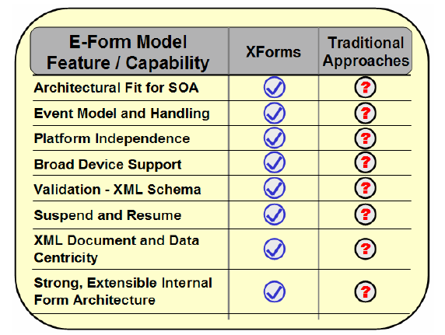
Introducing XForms : The New Standard
Eventually, it was recognized that organizations had been repeatedly faced with a set of challenging issues.
In response, the W3C drafted and published the XForms 1.0 recommendation with the goal of standardizing the next generation of e-forms.

Slide 14
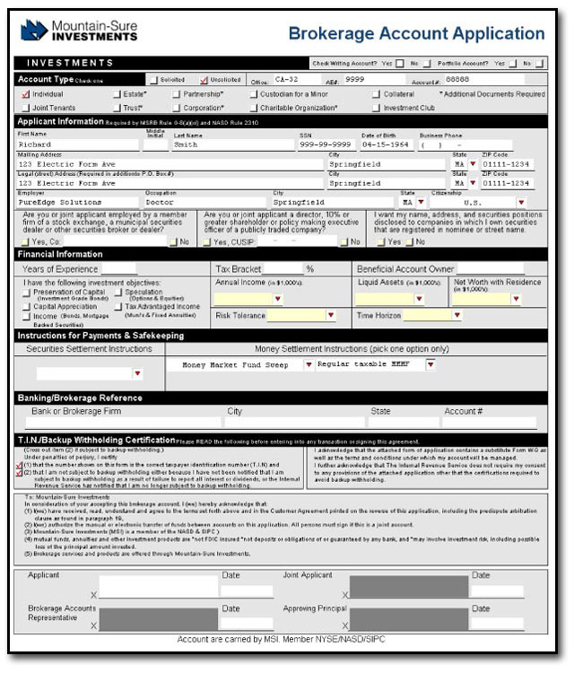
E-Forms Document Model
Presentation Layer
Pixel-perfect for duplicating paper forms
Guided-interview, or wizard, driven
Notes:
<segue, often spoken to on the slide before this one> At the center of our technology is the form itself. We are proponents of a “document centric approach” – a single XML form document contains, the User Interface, Data Model, Validation Rules and Business Logic, and also any required attachments / supporting documentation. Let’s keep in mind that all of this is still 100% XML, a “self-describing” e-form.
Rich user experience for presenting information and gathering responses
Presentation: multi-page capacity, wizard front-ends, and precision layout and appearance control on screen and in print
Responses: data validation and formatting (dates, currencies, SSN, phone numbers, etc.), organized attachments, and enriched text
Offline processing and simplified workflow supported by document-centric architecture
Rich design experience point-and-click design of rich presentation and binding to XML data, form fragment template re-use, property sheets, wizards for computes, signatures, tab order

Slide 15
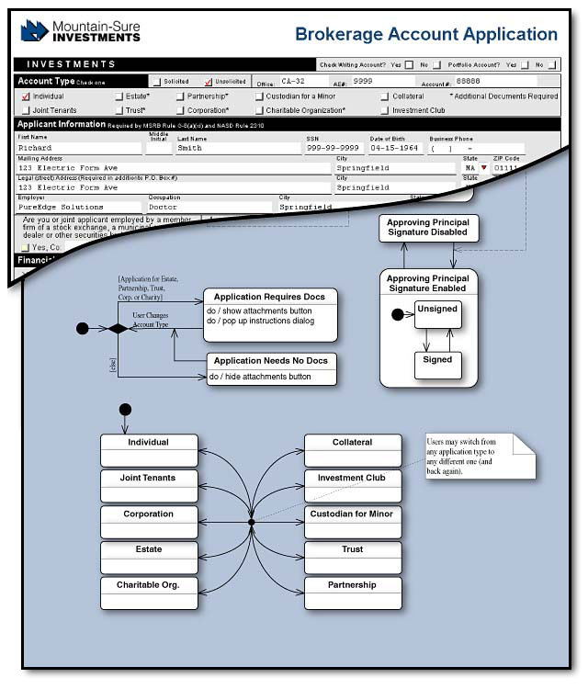
E-Forms Document Model
Presentation Layer
Pixel-perfect for duplicating paper forms
Guided-interview, or wizard, driven
Business Logic
Capture forms processes in the form
Integrate business process workflows
Notes:
Validation logic ensures that the necessary information is complete and valid
Content-process fusion: Process rules declared over XML data provides firmament for event-driven change through imperative action sequences over the XML data
SOA vision leveraged by marshalling web services to help complete larger tasks

Slide 16
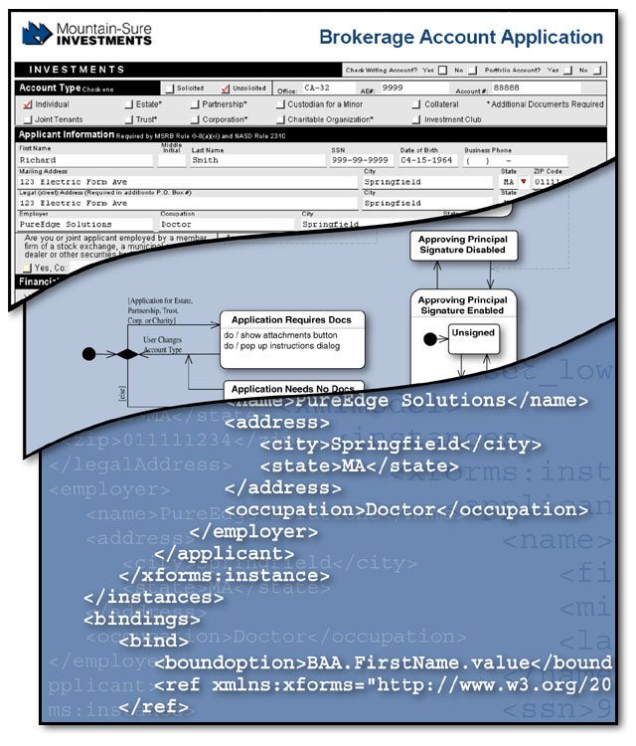
E-Forms Document Model
Presentation Layer
Pixel-perfect for duplicating paper forms
Guided-interview, or wizard, driven
Business Logic
Capture forms processes in the form
Integrate business process workflows
Data Instances
Based on W3C XForms specification
Multiple XML payloads for integration
Notes:
Workplace Forms supports multiple ‘arbitrary’ XML data instances. These instances are typically based on schema or interface definitions from other external systems. This makes integrating easy and efficient – one simply extracts the desired instance without performing any translation or assembly.
XML Content Kernel: Forms process XML data conforming to XML schema of services

Slide 17
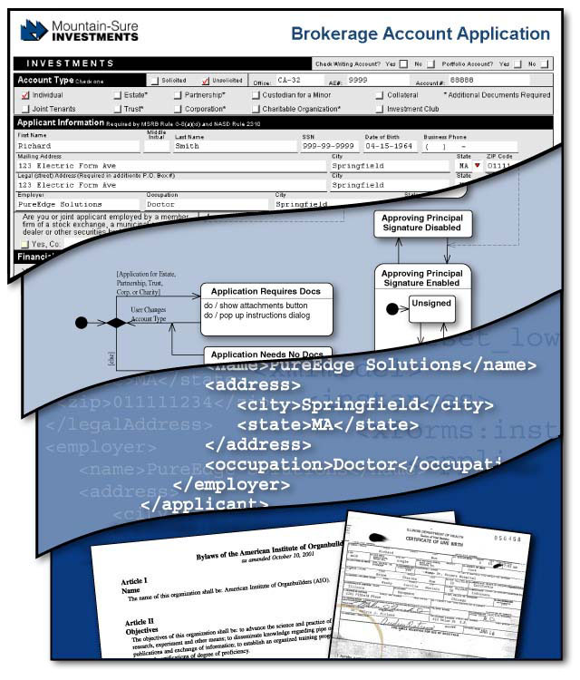
E-Forms Document Model
Presentation Layer
Pixel-perfect for duplicating paper forms
Guided-interview, or wizard, driven
Business Logic
Capture forms processes in the form
Integrate business process workflows
Data Instances
Based on W3C XForms specification
Multiple XML payloads for integration
Validate against external XML Schemas
File Attachments
Supplemental or associated e-forms
Any other files: MS Office, videos, images, etc.
Notes:
Workplace Forms also allow us to enclose supplementary documentation. This could be a scan of a client’s drivers license, a spreadsheet, digital images or video.
<Anecdote>
An example of a client putting this to practice is the SEC (Securities and Exchange Commission). The SEC requires all publicly traded companies in the USA to make what they call “EDGAR” filings. These filings are made using Workplace Forms technology, and these submissions often contain a range of supporting attachments – sometimes 50 to 100 MB in total

Slide 18

E-Forms Document Model
Presentation Layer
Pixel-perfect for duplicating paper forms
Guided-interview, or wizard, driven
Digital Signatures
Sign multiple, overlapping sections or complete form
Use built-in signing, digital certificates or signing pads
Business Logic
Capture forms processes in the form
Integrate business process workflows
Data Instances
Based on W3C XForms specification
Multiple XML payloads for integration
Validate against external XML Schemas
File Attachments
Supplemental or associated eForms
MS Office, videos, faxes, etc.
Notes:
Lastly, one can apply digital signatures technology to make the form tamper-proof and ensure transaction auditability. Workplace Forms provides industry-leading digital signature flexibility -- security can be applied at the field, section or page level; single or multiple approvals, and even out-of-order sectional signing/approvals. Our signature technology has been thoroughly tested by the US DoD (Department of Defense) and has held their “JITC” certification for several product generations.

Slide 19
E-Forms Document Model
Presentation Layer
Pixel-perfect for duplicating paper forms
Guided-interview, or wizard, driven
Business Logic
Capture forms processes in the form
Integrate business process workflows
Data Instances
Based on W3C XForms specification
Multiple XML payloads for integration
Validate against external XML Schemas
File Attachments
Supplemental or associated eForms
MS Office, videos, faxes, etc.
Digital Signatures
Sign multiple, overlapping sections or complete form
Use built-in signing, digital certificates or signing pads
Single – 100% XML document
Notes:
Workplace forms tie this all together in a single, 100% XML document. This document-centric approach is one that we strongly believe in, rather than a data-centric approach.

Slide 20

Importance of Enforceable Transactions
3 fundamental requirements for Enforceable Transaction Records
Agreement:
A contract must encapsulate all the elements of a business agreement in a single, secure document.
Acceptance:
A clear indication of the desire by all parties to be bound by the terms of the contract must be recorded.
Authenticity:
To be valid, a contractual record must be demonstrably authentic and unaltered.
Notes:
These are the three things that are required, in both the paper and electronic world
First talk about the paper world and how these three things are relevant.
The next slide talks about how Workplace Forms is doing the same thing in the electronic world, while still maintaining the ideas

Slide 21
XForms supports Enforceable Transactions
xForms Documents can meet the 3 fundamental requirements for
Enforceable Transaction Records
Agreement:
Data, presentation and logic are preserved in the transaction record.
Acceptance:
xForms technology can integrated with the industry leading electronic signature vendors (VeriSign, Digital Signature Trust, Entrust, PenOp, etc.)
Authenticity:
xForms is based on open standards (XML)
  Records can be verified by independent third parties.
  Unaltered records can be read into the foreseeable future.
Notes:
Agreement: Keeping data, presentation and logic together in one file is a big departure from the standard XML world, but is necessary for non-repudiation, etc.
Acceptance: Workplace Forms partners with as many vendors, and different technologies, as possible.
Authenticity: By being based on an open standard, we ensure that we will be able to authenticate the documents far into the future.

Slide 22

E-Forms in Summary:
– Elegance of Document-Centricity
By treating forms as objects it becomes simple to:
  Save a form and work offline
  Route a form using any available transport mechanism (e.g. Web, Email, etc.)
  Archive a form into a database
  Pre-fill a form with data and extract data from a form
  Make a form tamperproof
  Integrate a form with other technologies (i.e., workflow, document management, content management, Databases, Applications etc.)
Online- Offline Access
Notes:
In 6.0 and beyond, the emphasis is on integration. The toolset is fantastic on it’s own, but now we need to integrate the document into other processes.
Having everything in one file makes integration much much easier.

Slide 23
Services Oriented Architecture

Slide 24
What is SOA?
It’s Web Services.
It’s an Enterprise Service Bus.
It’s Workflow.
It’s Components.
It’s just Client-Server all over again …
ANSWER: All of the above.
“SOA” represents both an opportunity and a competitive necessity, created by the emergence of web- and standards-based- technologies …
Notes:
I imagine everyone here already has some idea of what SOA is. I don’t want to belabor the obvious points about web services, enterprise service bus, and the like. I think all of these technical points are right, and they’re important, but they’re not the most important things about SOA.
I think the most important thing here is that the SOA technologies and standards have both matured to the point that makes the SOA architectural style not only feasible, but makes it a competitive necessity. This is one of those “game-changing” events, where a technology advances in effectiveness beyond a critical point, and suddenly it becomes a must-have for everyone.

Slide 25



SOA Definition is still Evolving
“A set of components which can be invoked, and whose interface descriptions can be published and discovered.”
Component Based Development and Integration Forum
“The policies, practices, frameworks that enable application functionality to be provided and consumed as sets of services published at a granularity relevant to the service consumer that can be invoked, published and discovered, which are abstracted away from the implementation using a single, standards based form of interface.
“Service-oriented architecture is a client/server software design approach in which an application consists of software services and software service consumers (also known as clients or service requesters). SOA differs from the more general client/server model in its definitive emphasis on loose coupling between software components, and in its use of separately standing interfaces.”
Notes:
Here are some of the definitions you’ll see in the marketplace and in the standards area … as you can see the W3C has a pretty terse definition, mainly anything based on interfaces is a SOA. CBDI – the Component Based Development and Integration Forum, a consultancy devoted to SOA – goes a little further, emphasizing frameworks, and the standards-based means of expressing and accessing interfaces. Finally, Gartner, expands still more, emphasizing loose-coupling as a key property of SOA, but more importantly calling it a design approach.

Slide 26



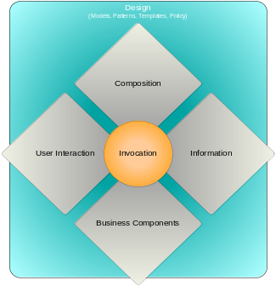

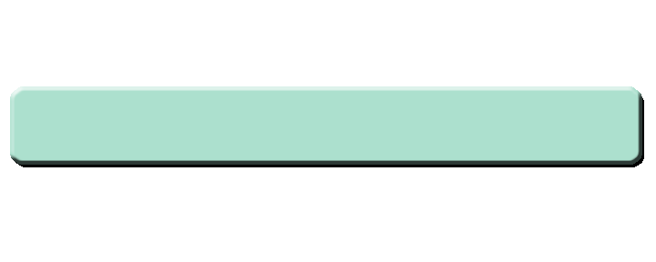


Working Definition of SOA
A design pattern for systems, based on organization of business functions into components, and on reuse.
An implementation pattern, based on interfaces for needed services, loose-coupling between components, and standardized protocols for access.
A technology strategy that describes uniform standards and methods across an organization.
Notes:
Here’s what I propose as our working definition of SOA. First of all, it’s a design pattern for systems, where you factor needed capabilities into components, and then reuse those components across your organization. Note that I’m not talking “little” components here, like a Java bean – I’m talking business components, such as an Insurance Claims Component, or a Policy Component. In fact, this modeling of an organization’s business functions into separate contained components is an essential discipline in planning an overall SOA.
Next, its an implementation pattern, where you create specific features you need by employing all the interface, loose-coupling, and standards-based methods that developers all associate with SOA.
Finally, SOA has to be thought of as a technology strategy. So many of SOA’s benefits cannot be achieved unless there is uniform adoption across your organization. Now some of that is for the future, certainly, and I’d never say the only way to do SOA is for everything to convert to web services all at once. However, as we’ll talk about in some of the following slides, SOA benefits of adaptability are greatly diminished if only some of your business services can be combined with others in a standard model.

Slide 27
Why is SOA Important?
Reuse drives down development costs exponentially over time.
Standards-based solutions (XML, Web Services) across the layers, not just integration.
It uses a new way to develop prototypes using Business Process Mapping rather than the old spec approach to designing and prototyping.
Rapid application development with composite application tools.
Leverages existing solutions - does not replace them.
Gartner: … by 2008, "SOA will provide the basis for 80 percent of new development projects."
Notes:
We have a definition for SOA … now, why is that important? Here’s a question that many manufacturers, insurance companies, health care providers, financial services firms, major retailers and automakers are asking--- just to name some of the industries where SOA has greatest adoption now. What happens if your IT operations are 25% less efficient than your competitors’? What happens if it takes you longer than them to make changes in a business process?
SOA has many properties that enable these efficiencies. By factoring business functions into specific components, it eliminates redundancies and mandates reuse of services exposed by a single, organization wide component. Since the technology is based on XML and other standards, and those are so pervasive, you can use the same data-structures end to end – there’s much less need to convert to intermediate formats as you move from tier to tier or system to system.
By emphasizing abstract business services and de-emphasizing implementations, you can now do modeling of business processes, and quickly translate models into running code. Formerly when there was so much disparity in system types – so much “uniqueness” if you will – every integration effort needed a massive specification exercise that focused more on the mechanics of systems talking to each other, than it did on the problem being solved.
Its these and other properties of SOA that leads analyst Gartner to state that by 2008, SOA will the basis of 80% of new development. I think its fair to say that today, organizations of all sizes are rapidly adopting the core SOA technologies of XML and web services, and many are putting into production “full blown” deployments.

Slide 28
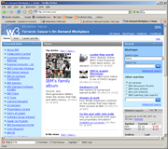
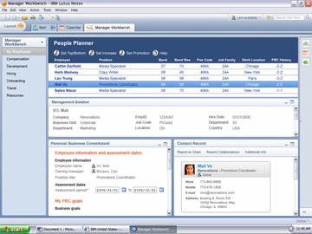

What does SOA Look Like?
Presentation
Layer
Portals
Rich Clients
Mobile Clients
Business
Object
Layer
Business Components & Web-Services
Data
Layer
Stores-of-Record
Legacy Systems
Notes:
Let’s talk a bit about what the technology and deployment of SOA actually looks like. While there’s lots of different ways of picturing SOA, and different reference architectures from different vendors, this pattern is common to all of those. It starts with a data layer. This contains your systems-of-record, for example your product-catalog system or your fulfillment system. Some of the entities in this layer may well just be databases, but most are actually running application systems – that includes legacy systems.
Next we have the business object layer. This is where the actual web-services live, where they are implemented. Some of these business objects are application code that is tied to a given database. Some other of these objects are wrappers on top of a legacy application or some other running system. The main property of this layer is that, once you get here, everything in this layer is invoked or accessed in the exact same way. Every capability here is a service, with a WSDL definition, that you can create stubs and bindings from using any WSDL-compatible tool. Note that you can have services that span multiple datastores or systems.
At the top is the presentation layer. These are the different client types and client apps than ultimately access the services. As you can see, there’s much more cross connection that can happen at this layer. In many cases, all different types of clients will access a single service – meaning that a browser, a rich client, and a mobile device could all access the same service. Lookup-type services are the most prevalent example here … lookup a person, a product, etc. Other cases, the service is relevant to a single client type only. Anyway, I won’t say much more about the presentation layer now … the user-interaction patterns we’ll talk about later are all about how to view the presentation layer in SOA.

Slide 29
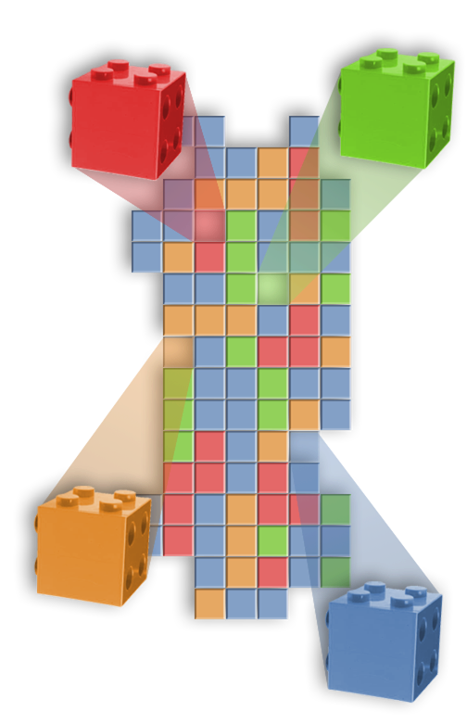
What is SOA…?
… a service?
A repeatable business task – e.g., check customer credit; open new account
… service orientation?
A way of integrating your business as linked services
and the outcomes that they bring
… a service oriented architecture?
An IT architectural style that supports
service orientation
… a composite application?
A set of related & integrated services that support a business process built on an SOA
Notes:
Let’s start by looking at some base-line definitions so we’re all talking about in the same terms.
First of all, what is a service? <read definition> It’s important to stress that we’re talking about a part of a business process here. Don’t think about software or IT. Think about what your company does on a day to day basis and break those business processes up into repeatable business tasks or components. These services can be implemented with a variety of technologies, one of which being standards-based Web Services.
Second, what is Service Orientation? Building on our definition of a service, Service Orientation is a way of integrating your business as linked services and, more importantly, the outcomes that they bring. We’re still not talking about technology; we’re talking about a thought process and a business philosophy.
What is a service oriented architecture? It is quite simply the IT architectural style that supports the Service Orientation thought process makes it a reality.
More detail:
A service-oriented architecture (SOA) is an approach to IT that builds business processes from reusable component modules or "services" that are independent of applications and the computing platforms on which they run.
An architecture that leverages open standards to represent software assets as services
Provides a standard way of representing and interacting with software assets
4) And finally, what is a Composite Application? <read definition> So composite applications are the actual running services that have been assembled and strung together to support what a business does. SOA helps make building and adjusting composite applications fast and easy.
More detail:
Individual software assets (services) become building blocks that can be reused in developing other applications
This shifts focus to application assembly rather than implementation details
Used internally to create new applications out of existing components
Used externally to integrate with applications outside of the enterprise

Slide 30
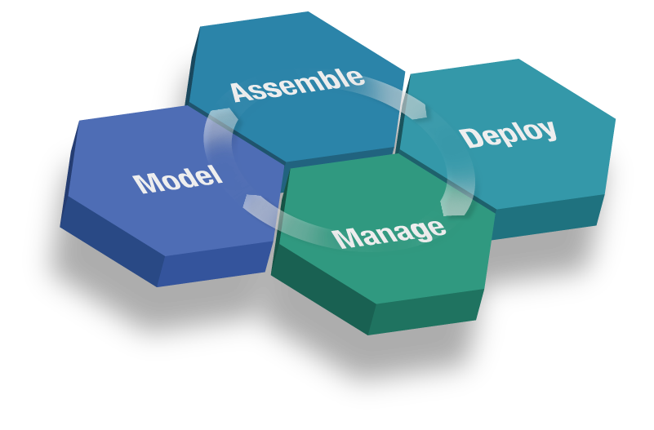
SOA Engagements Demonstrate Key Elements for Success
The SOA Lifecycle
Discover
Construct & Test
Compose
Integrate people
Integrate processes
Manage and integrate information
Gather requirements
Model & Simulate
Design
Financial transparency
Business/IT alignment
Process control
Manage applications & services
Manage identity & compliance
Monitor business metrics
Notes:
*Main point: SOA is best considered in terms of a lifecycle. Think of this lifecycle comprehensively and approach it tactically focusing on the sections that provide the most value for you.
Our customers have told us that they take a lifecycle approach to SOA.
They start in what we are calling the Model phase by gathering business requirements, designing, simulating, and optimizing their desired business processes. That way, they can make sure they are setting the right steps in motion before further action is taken.
Once they have optimized the business processes, they implement it by combining newly created and re-used existing services to form composite applications.
The assets are then deployed into a secure and integrated environment taking advantage of specialized services that provide support for integrating people, processes and information. This level of integration helps ensure that all the key elements of your company are connected and working together.
Once deployed, customers manage and monitor the composite applications and underlying resources from both an IT and a business perspective. Inf,ormation gathered during the Manage phase is used to gain real-time insight into business processes enabling better business decisions and feeding information back into the lifecycle for continuous process improvement.
Underpinning all of these lifecycle stages is governance which provide guidance and oversight for the SOA project. Two ways to view governance. There is IT governance and Business Governance. The former is about how are going about deploying an SOA – are you reusing assets? Are there review teams for applications? Are there documented best practices. The later is all about business controls, projection of corporate strategy to all end nodes of the business .

Slide 31


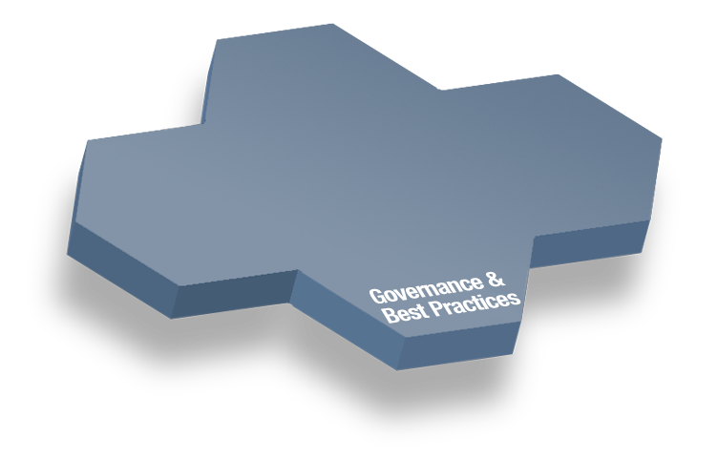




The Top Benefits of Business Flexibility with SOA
Productivity
Agility and compliance
Easier change management
Single source of information
Collaboration
Customer experience
Roll-based access for all
Tasks provided by others
Responsiveness and service
New opportunities
Reduce transaction time
Expand access to apps and systems
Notes:
….so we took a look at the strong market demand, we talked about our competitive advantages…. and now…as we look at this chart… we see that SOA provides significant business benefits that can help set up additional sales.
For example, customers want easier change management, e.g. the need for quickly changing existing business processes, utilizing reusable assets that enable companies to reduce costs
They also want role-based access to a collaborative application environment
….and the good news, the Workplace, Portal and Collaboration products are ready to meet your customer’s SOA goals today!
But before we talk about how the WPLC products deliver value for an SOA, <name> will take through the fundamentals of SOA…
<additional speaking points>
For example, customers want easier change management, (call out the need for quickly changing existing business processes, providing reusable assets that enable companies to reduce costs and increased access to all types of information) We see the cycle time shrinking between changes in business processes. While you might have seen companies make significant changes yearly in the past, you’ll see the same level of change on a monthly or even weekly or daily basis. Bottom line is that you are in a great position to make initial sales based on this extended level of flexibility.
….and the real good news is that like the other brand teams in IBM Software Group, the Workplace, Portal and Collaboration team (WPLC) has a range of products and solutions that are ready to meet your customer’s SOA goals today!
Recall the Gartner quote “Through 2007, an enterprise portal will be the first major application of SOA concepts for more than 50 percent of enterprises “ well….we have the market-leading portal product…WebSphere Portal
And so you can lead with the products that solve the near term business goals while positioning yourself for additional sales soonafter:
e.g. You can start by selling WebSphere Portal or Lotus Notes/Domino now and come back later to extend the portal with collaborative capabilities or leverage all those existing Lotus Domino applications by bringing them into a portal environment based on SOA.
We’ll take a closer look at how the WPLC portfolio delivers a range of products to meet your customer’s needs but let’s first spend a few minutes to understand the fundamentals of SOA and then transition to how the IBM Workplace portfolio from WPLC plays a key role in IBM’s SOA strategy to deliver business value to your customers.

Slide 32
SOA and E-Forms

Slide 33
SOA and E-Forms
Standard design considerations apply for e-form solutions
Client-side:
  Submission or retrieval of real-time data or business rules
  Access to a broad range of Web Services
Server-Side:
  Integration – all of the classically derived benefits of componentization and reuse, loose coupling.
  When integrating a Form into the back office, the use of SOA decreases complexity
Because of XML-based technology, complete separation of data-model and presentation layer, often no need for translation
Notes:
As is the case with other Web and Portal applications, Web Services is an important technology that we can leverage within E-Form applications. For the purposes our demonstration later today, we’ll consider the most common implementation of SOA, that is, Web Services using Simple Object Access Protocol (SOAP) and WSDL. The standard means of service modeling, discovery, and management apply when delivering service-oriented e-form solutions.

Slide 34
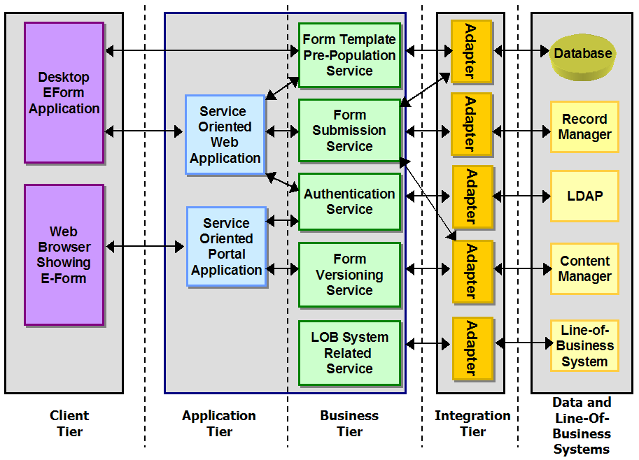
Example Service-Oriented E-Form Application
Standard design principles apply.
Componentization and reuse provide standard benefits and efficiency improvements.
Note the Content Manager Adapter … leveraged by both the Form Submission and Form Versioning Service.
Example diagram – not exhaustive!
Don t Repeat Yourself (DRY) Principle of SOA
Notes:
As you can see, a number of the services within the business tier are encapsulations of specific form application-related functionality, designed for reuse across multiple applications. Recalling the e-form solution interactions discussed previously, it makes sense to extend the example solution shown in figure 4 by designing and implementing a Digital Signature Certificate Validation Service that encapsulates and abstracts interactions with one s Public Key Infrastructure (PKI). Another point worth mentioning is that, within the Client Tier one can assemble composite applications that leverage one or more e-forms. An example of this would be to combine a client-list Portlet with a new account application form. One could potentially use click-to-action on the client list to populate an empty form template with client data.

Slide 35

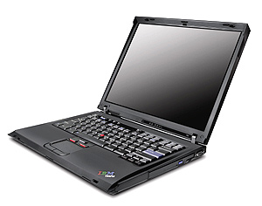
An illustration - Server-Side Web Service Interaction
More Common
Request Blank Form
Web Service Call
Web Service
Pre-Populated
Form
Form Template Pre-Population
Client accesses a form via a Web site by clicking a link
Server loads specified form template
Server loads data from Database or other system
The XML data instance is into merged into the form
The form is returned to the end-user
The pre-populated form is presented to the end user
Notes:
One of the most common scenarios is one in which we “pre-populate” an empty form template. In this chart we see an example of form pre-population on the server-side. Based on a user’s identity, we’ve made a web-service request for data which will be used to pre-populate a form template. From the user’s perspective, all of this happens seamlessly. They simply follow a link on a web or portal page and are presented with an already partially completed application form.

Slide 36
An illustration - Client-Side Pre-Population via Web Services
Real-Time Data
Web Service Call
DB Query
Database
SOAP / HTTPS
SQL
Form Template Pre-Population
Client accesses a form via a Web site or launches it from the desktop.
The client application sends a Web Service request to the server
The response contains either:
  An XML Data Instance
  A Single Value (e.g. account balance)
The new, real-time data is presented to
the end user.
An XML based protocol
for information
exchange in distributed
environments.
SOAP
Notes:
In some cases, real-time data or business rule parameters is required. Wire-transfers of funds are an example where up-to-date information is important. This scenario tends to be less common, however Workplace Forms make this type of integration easy as one can embed WSDL directly within the form. Later on in this session, we’ll walk through an example of how one can do so.

Slide 37
SOA Enabling e-Forms
When building a SOA based Form, start with the Web Service
  There are many technologies to help build a Web Service
  One of the artifacts is a Web Service Description Language (WSDL) document.
  This document describes the available services, the XML and the URL’s

Slide 38
In Summary….
Customers are adopting SOA today to gain business flexibility
  21% of companies surveyed have deployed SOA
  33% plan to deploy SOA within the next 12 months
XForms represents a compelling open-standard alternative for developing Web- and Portal-based e-form applications. The document model and technological foundations of XForms make it an excellent choice for standardizing eforms technology within your service-oriented infrastructure.
Notes:
In summary…. the business value provided by the IBM Workplace software is about maximizing people productivity, …and doing so within the context of an SOA.
Highlight each bullet with a summary statement

Slide 39

Q & A
Thank-you for your time today
Gopi Srinivasan
gopisrin@in.ibm.com

